Slide 1

General Biology
Dr. sraa nsayef

Slide 2
Chemistry of life
Lec ((3))

Slide 3
Chemistry of life
The molecules of life (carbohydrates, lipids, proteins and nucleic acid) are organic molecules.
Organic: type of molecule that consist primarily of carbon and hydrogen atoms.
Carbon is a central element to life because most biological molecules are built on a carbon framework.

Slide 4
1- Carbohydrates
Carbohydrates are the most abundant biological molecules. Cells use carbohydrates to help build cell parts or package them for energy
monosaccharide's (monomers)
oligosaccharides (Dimers)
Polysaccharides (polymers)

Slide 6
A. Monosaccharide's:- The simple class of the carbohydrate,
Consisting of a single sugar monomer, glucose molecule is example.
B. Oligosaccharides:- carbohydrate that consist of short chain of sugar unit, sucrose is example.
C. Polysaccharides: complex carbohydrate that consist of straight or branched chains of monosaccharide.

Slide 7
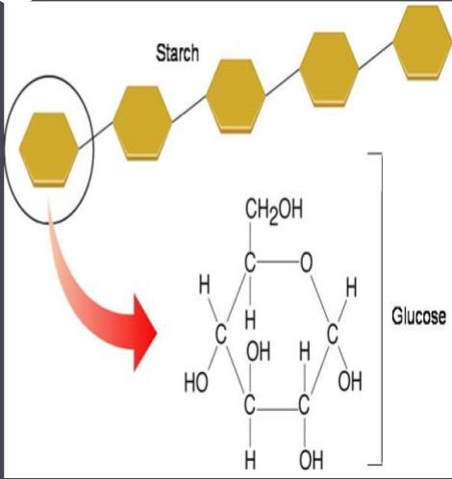

Slide 8
2- Lipids
The most important characteristics of lipids for biology is that they are relatively insoluble in water. The most important subclasses in your body are triglycerides, phospholipid and steroids.
There are two type of Fatty acids?
1- Saturated fats
2-Unsaturated fats

Slide 9
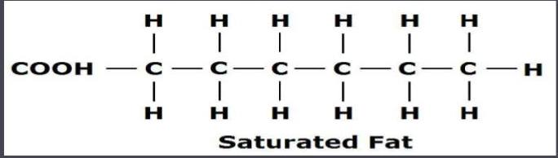
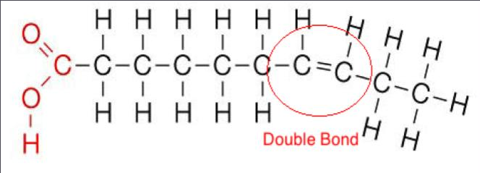
Unsaturated fats

Slide 10
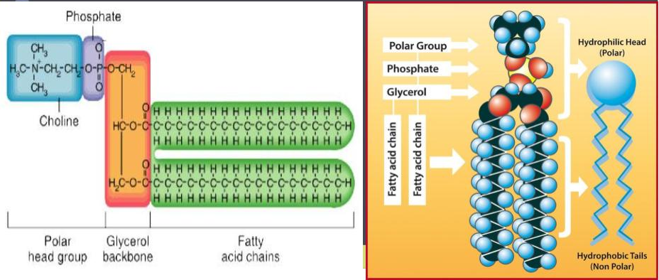
Phospholipids: they are the primary structural component of cell membrane. Like fats, phospholipids have a molecule of glycerol as the back bone, but they have only two fatty acids tails.

Slide 11
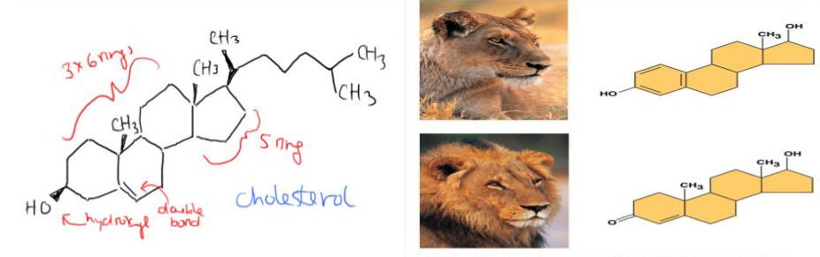
Steroids consist of backbone of 3 six- membered carbon rings and 1 five membered carbon ring to which any number of different groups may be attached.

Slide 12
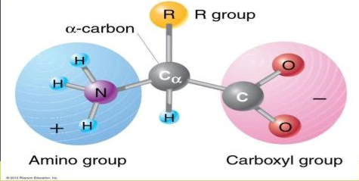
3- Proteins
Proteins are built from amino acids. Amino acid is a small organic compound that consists of an amino group, a carboxyl group (an acid), an atom of hydrogen, and one or more atoms called its R group.

Slide 13
4-Nucleic acids
Another important class of organic molecules is the nucleic acids, DNA (deoxyribonucleic acid) and RNA (ribonucleic acid).
A molecule of DNA Nucleotides
Each nucleotides consist of:-
*Phosphate group
*Sugar group
*Nitrogenous base.

Slide 14
